Slide 1
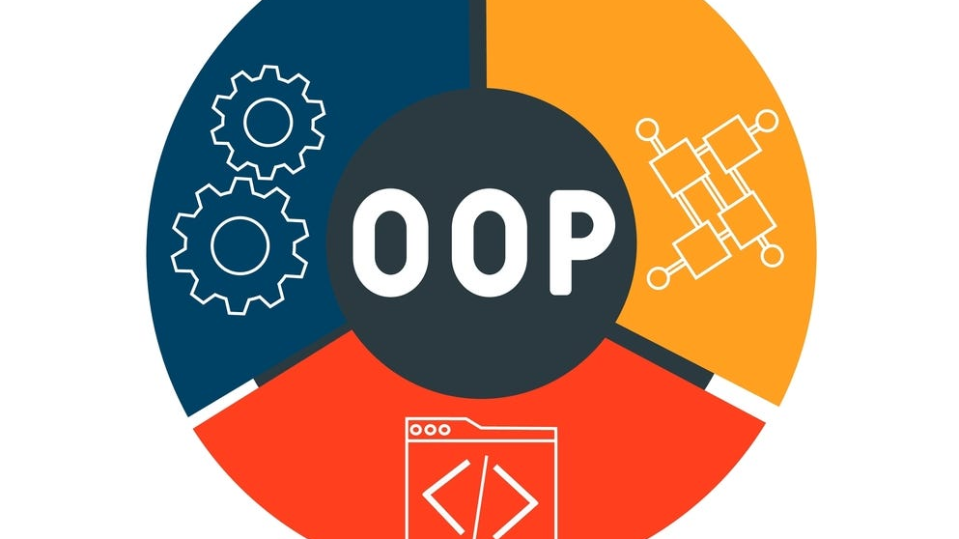
Object-Oriented Programming in C#
(OOP)

Slide 2

What is OOP?
Object-Oriented Programming is a programming paradigm that uses objects and classes to structure software programs.

Slide 3
Concepts of OOP
Class: A blueprint for creating objects. It defines the properties and behaviors.
Object: An instance of a class. It has a state and behavior.
Method: A function defined inside a class, representing a behavior.
Property: Attributes that define the state of an object.

Slide 4
Advantages of OOP
Code Reusability: Classes and methods can be reused across different programs, reducing redundancy.
Scalability: Makes it easier to scale programs as new functionalities can be added by extending existing classes.
Modularity: Code is organized into separate classes, making it easier to maintain and update.
Data Security: Encapsulation helps protect data from being accessed directly, ensuring better data security.
Easy Troubleshooting: With objects representing real-world entities, finding and fixing issues is more straightforward.
Improved Collaboration: Promotes teamwork, as developers can work on different classes or modules independently.

Slide 5

Classes
Class is a blueprint or template for creating objects. It defines the properties (attributes) and behaviors (methods) that the objects will have.
Attributes (Fields): Variables that hold the data or state of the objects.
Methods (Functions): Define the behavior or actions that objects created from the class can perform.

Slide 6
Objects
Object is an instance of a class. It represents a concrete entity with a specific state and behavior.
Created using the new keyword.
Each object can have different attribute values, even if they belong to the same class.

Slide 7

Relationship Between Classes and Objects
A class serves as a template, while an object is an instance created based on that template.
Multiple objects can be created from a single class, each with unique attribute values.

Slide 8
Real-World Applications of OOP
OOP is used in game development, web applications, and software design.
1
Case studies or examples from popular frameworks (e.g., .NET).
2

Slide 9

Summary
Object-Oriented Programming (OOP) is a programming approach that uses objects and classes to model real-world entities and relationships. It enables developers to structure code in a way that is modular, making it easier to manage, maintain, and extend. OOP helps organize complex programs by encapsulating data and behaviors within objects, which represent entities with specific attributes and functionalities.

